Slide 1
Quartz Fiber Luminometer for Phase II CMS (addressing recommendations)
Daria Selivanova (NRNU MEPhI, RU)
On behalf of Quartz Fiber Luminometer team and BRIL

Slide 2
Idea of the project
The obvious advantages mentioned in the reviewers’ report
A quartz fiber based luminometer QFL (inspired by HF) to be installed at the CASTOR table
Quartz fiber bundle to generate Cherenkov photons and transport them out of “hot area”, e.g. under the CASTOR table
CASTOR table is a unique place in CMS:
1. The luminometer and its electronics can be accessed without opening CMS detector
2. Direct view of the IP
FE electronics can stay in the HF rack (5 m away from the photodetector)
Easy maintenance, replacement or upgrade of each component of the QFL
HF platform has all the needed infrastructure (power, gas, cables, fibers, etc.)

Slide 3
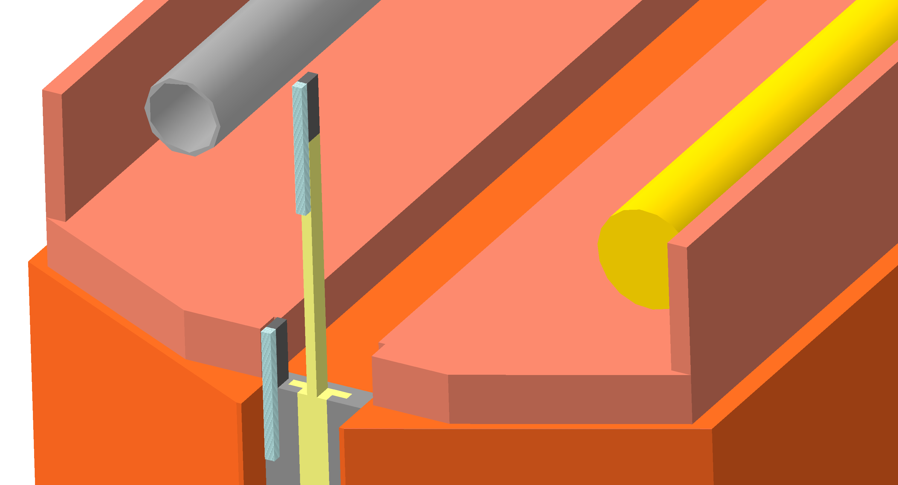
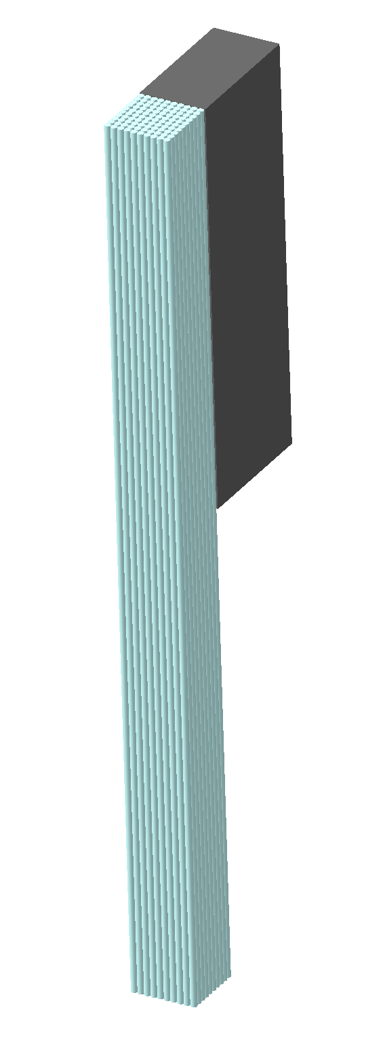
Geometry of the QFL
W80Cu20 converter,
1x2x6cm³
Quartz fiber bundle
~2m long
Photodetector
(SiPM, PMT or MCP)
Ouside of “hot area”
2 detecting channels, each consisting of W/Cu converter, quartz fiber bundle and photodetector
1st detector is fixed at R~40cm, its occupancy is optimized for maximum BbB luminosity
2nd detector is movable along R in range (10÷36)cm, depending on BbB luminosity
Both channels are read out continuously
A single geometry was chosen to show the concept

Slide 4
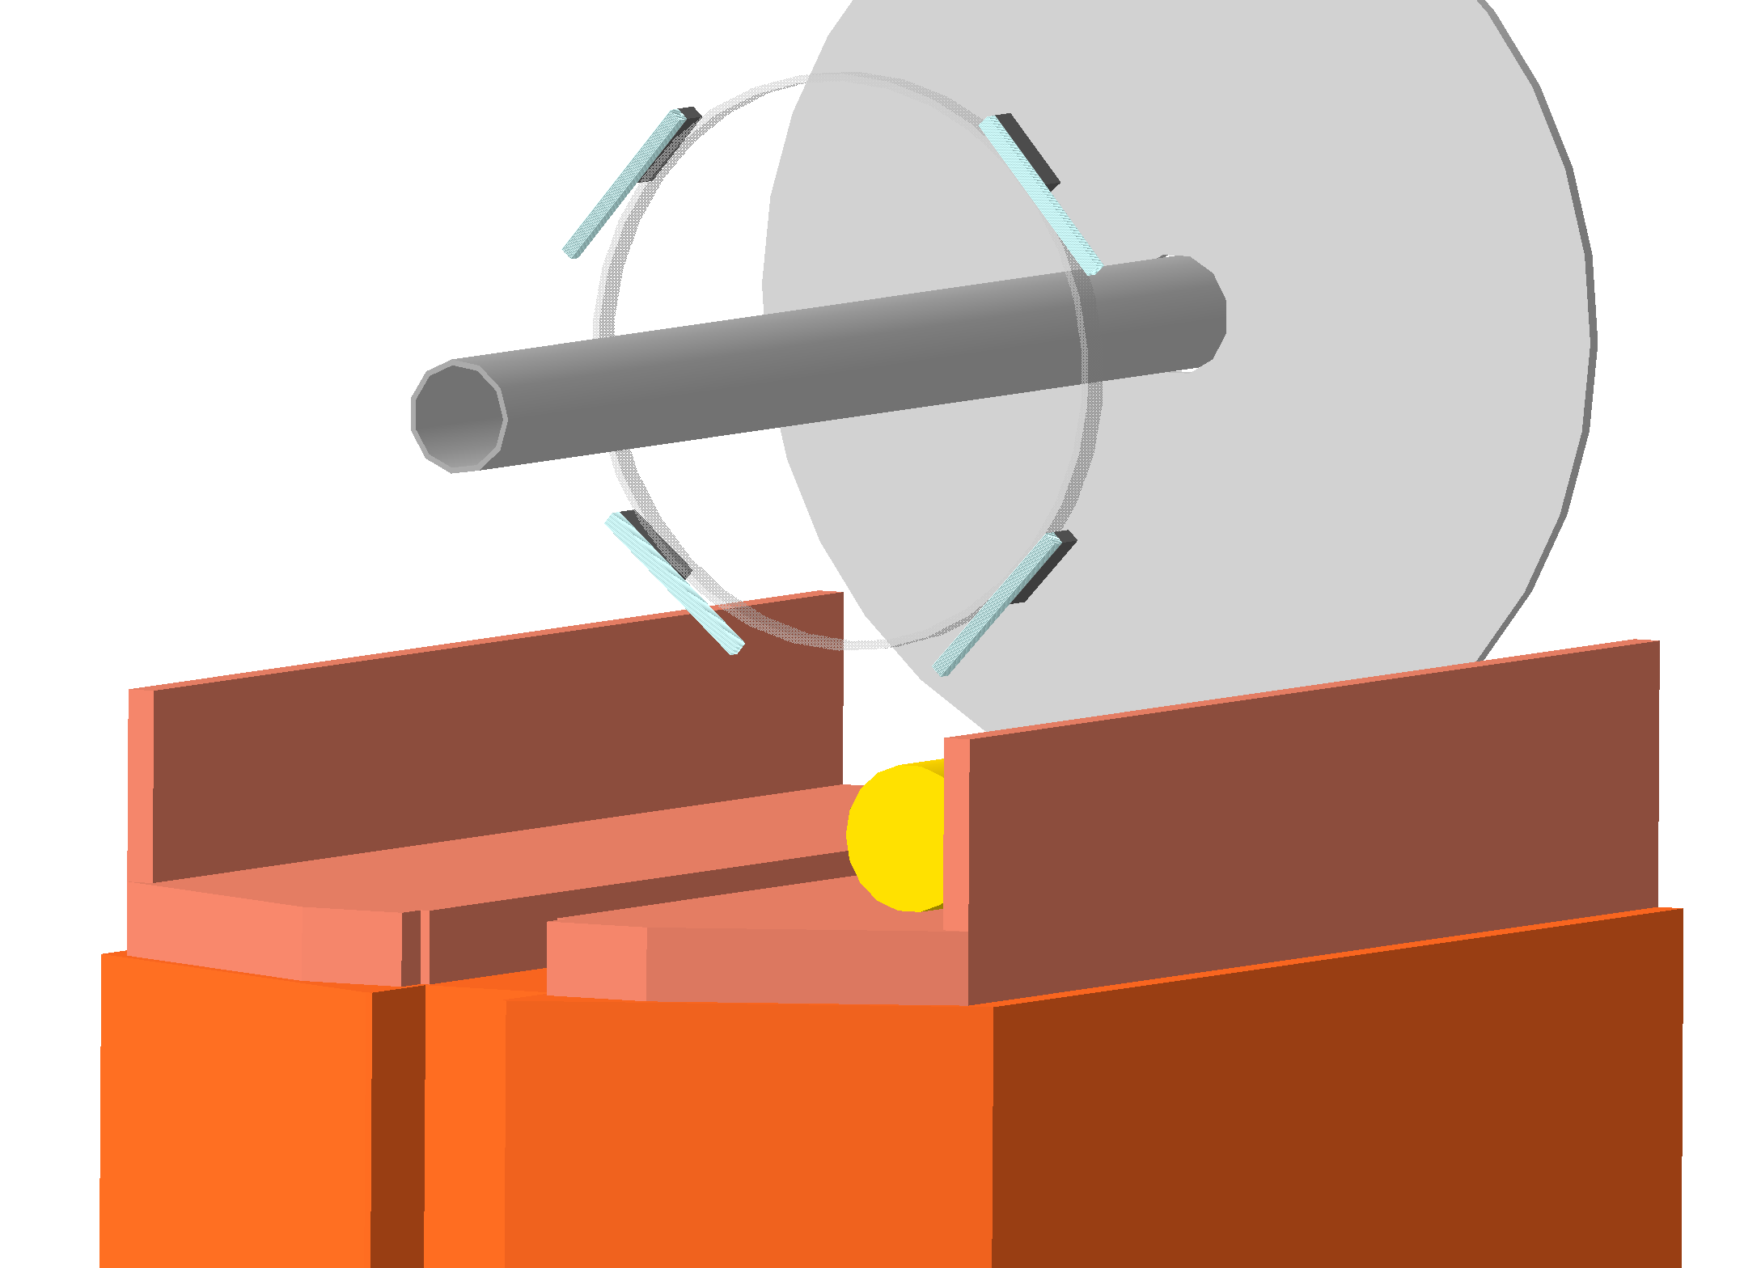
Geometry of the QFL
A symmetrical design was already though of
Z = 15200 mm
In order to minimize crossing-angle-related biases, the detector should be designed to be azimuthally symmetric.
6 to 8 sensors per side is recommended
The addition of more detecting channels would increase the statistical accuracy

Slide 5
Operational strategy
The optimal detector occupancy (p) from FE electronics is ~20%
Statistical accuracy per LumiSection (LS):
N_{events}= fr * LS * p = 11kHz * 23.4sec * 0.2 = 5*10⁴
so statistical accuracy = 1/sqrt(N_{events}) ≈ 0.45%
Statistical error per Nibble₄ is ~2%
Requirements driven by offline diagnostics in the physics regime.
Statistical requirements have already been divided
Operational/online requirements
Having 8 detecting channels whould change the statistical accuracy:
Statistical accuracy per LumiSection ~ 0.16% – Statistical error per Nibble₄ ~0.63%

Slide 6
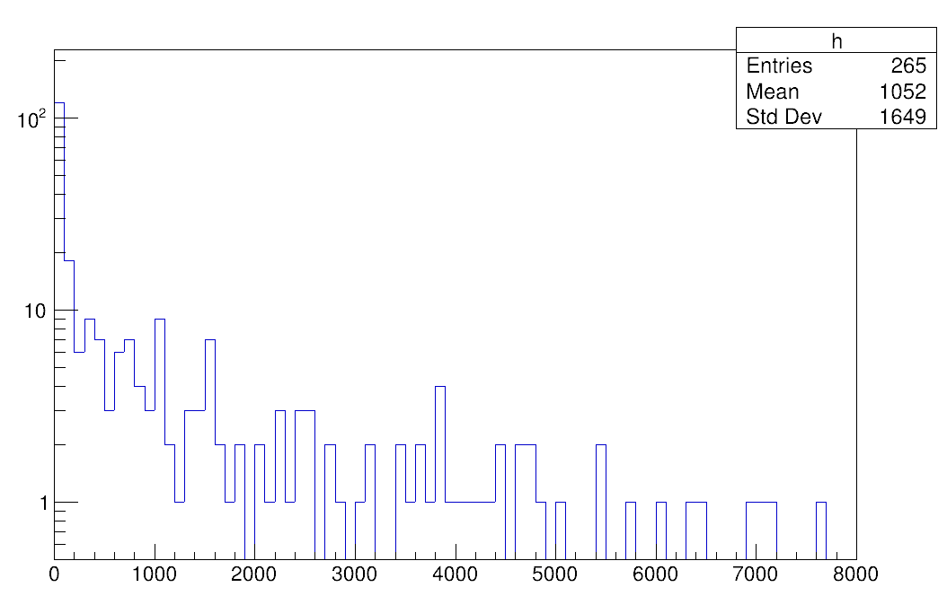
Operation strategy
Due to large fluctuations in the signal, we want to use zero counting method to calculate the luminosity
Number of photons at fiber’s output end
It was shown that signals of different amplitudes will be generated in the detector. Such low amplitude signals can add up in a single channel to larger signals which cross the threshold.
This effect will be a contribution to the non-linearity of the detector and needs to be carefully studied.
Count
Number of photons
The EM shower induced by incoming particles from 1 pp collision.
The fibers are in a bundle of 100.

Slide 7
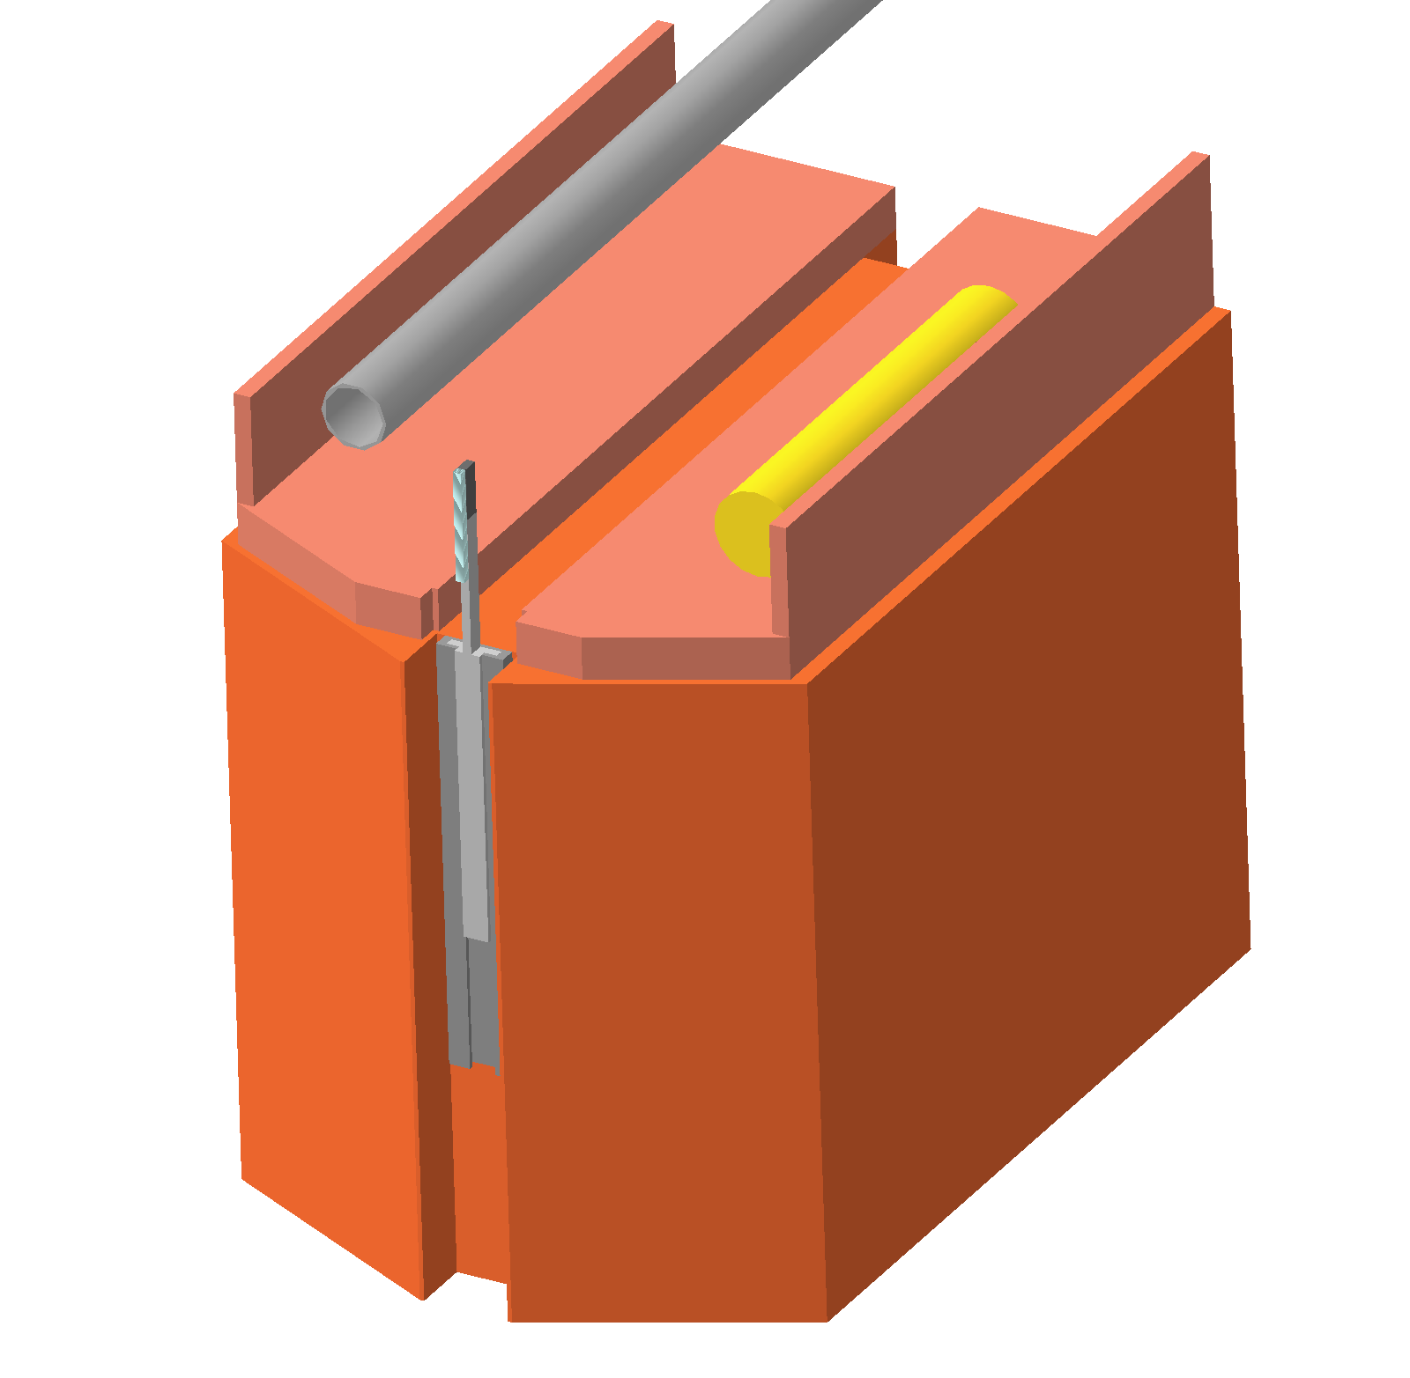
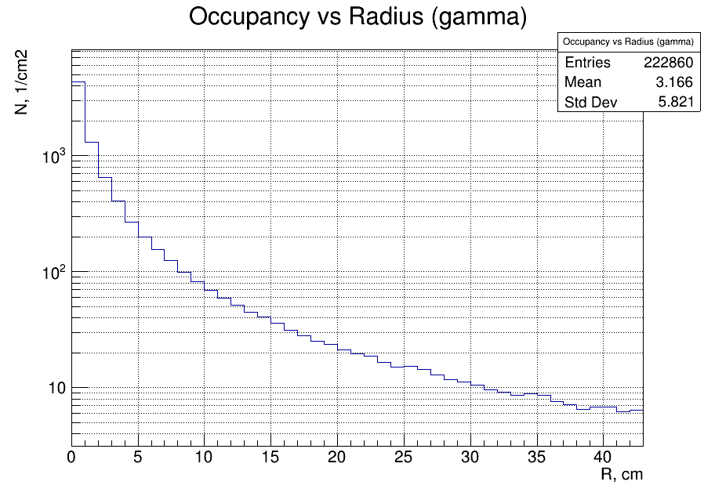
Why movable?
By moving the luminometer along R:
We can maintain the optimal occupancy both for
VdM scan (μ~1) and
physics runs (μ~100÷200)
Simulated
span
Number of hits per PP collision/cm2
The committee recommends that for each luminosity sub-system overall 1% luminosity-precision goal be broken down into its main components
Beam
Pipe
Castor
Table

Slide 8
Why movable?
By moving the luminometer along R:
Re-positioning of movable detector is needed only during bunch luminosity ramp-up or for the VdM scan
(not during operation, only few times per year)
Simulated
span
Number of hits per PP collision/cm2
It is recommended to equip those photosensors that will be movable, with a precision position measurement system which will be very useful to perform checks or during special runs where the sensors will have to be moved within short intervals.
Beam
Pipe
Castor
Table

Slide 9
Why movable?
By moving the luminometer along R:
Reduce the background created by the luminometer
Reduce the radiation damage to the quartz fibers
Reduce activation of the W/Cu converter
Simulated
span
Number of hits per PP collision/cm2
Requirements for the trade-offs between statistical reach, sensor radial position and radiation-induced detector ageing
Beam
Pipe
Castor
Table

Slide 10
Why movable?
From simulations we expect (1 ÷ 6 ) x ${10}^{6}$ Gy @ integrated luminosity of 3000 ${fb}^{−1}$
0 Gy
2.4 x ${10}^{6}$ Gy
1.25 x ${10}^{7}$ Gy
[2] K. Cankocak et al. / Nuclear Instruments and Methods in Physics Research A 585 (2008) 20–27
Evolution of the transmitted light spectra from a 1.25m of qq fibre as a function of dose
The quartz bundles will be changed during the span of the operation to ensure optimal light yield and propagation
Requirements for the trade-offs between statistical reach, sensor radial position and radiation-induced detector ageing

Slide 11
Simulation workflow
Geometry: W80Cu20 brick at z=1520cm, R=XX,
dimensions: LxWxD
Primary 50K events, 14TeV (Pythia8)
Shower in converter, secondary e+e- (Geant4)
Cherenkov photons in quartz fibers, capturing and transport
Signal in photodetector
FE electronics
...
Occupancy
Energy and angular distributions
Fiber type, quantity and geometry of the bundle
For the new systems still in the design phase, the simulation studies should characterize the robustness against incremental system failures (e.g. to what extent the luminosity precision will be affected when losing channels or when the system deteriorates in any other way during Phase-2).
The simulation should also investigate the effects of high pile-up on the front-end electronics that might have an important impact on the linearity of the response.
Photodetector PDE, spectral response
Number of photoelectrons (fired pixels)
Shaping time

Slide 12
Front end electronics
HF-type electronics (QIE10, QIE11) will do the job
Charge integration, Zero dead time, Huge dynamic range, 25ns
TDC on board, to spy inside 25ns
QIExx is single channel chip, but the readout is optimized for many channels
How to readout QIExx using Phase2 DAQ bricks?
PHASE2 electronics options:
TOA+TOT measurements, FastIC with or without picoTDC)
FastIC status ?, NINO (SuperNINO) wit or without picoTDC, HGCROC : how to get data out of the chip?
Modern NON-LHC electronics
40MHZ rates ?
The readout electronics should be designed such that hits in neighbouring BC slots (25ns) can be tolerated.

Slide 13
Self-calibration / monitoring
Calibration with LED or Laser diode
Radiation damage of quartz fibers changes the spectrum optical photons which reach the photodetector. We have to use the radioactive source to produce Cherenkov photons in the fibers.
Technically, the best option is to use a movable gamma source, because it allows to compare signal with/without source.
This technique is demonstrated at HF
All the sourcing machinery is permanently installed at HF platform
Sources are available
Calibration with radioactive source could be performed during technical stops
Due to radiation effects, it is essential to monitor the detector stability by frequent calibrations, ideally once in every inter-fill period.

Slide 14
Recommendations that still need to be addressed

Slide 15
Luminosity specific recommendations
Non-linearity corrections
Calibration transfer from the vdM to the physics regime
Requirements related to the ultimate offline-luminosity precision in
vdM scans
Routine physics operation
The statistical precision required both at the peak of the on-axis scans (µ ~ 0.5) and in the tails of the off-axis scans, at leas 3 orders of magnitude lower rate compared to the peak
To provide the necessary cooling to the sensors the following options should be investigated: Venturi tubes and thermoelectric coolers. Both allow for relatively efficient cooling in small volumes
A sufficient signal-to-noise (S/N) ratio at low luminosity, in particular in the tails of the vdM scans, needs to be demonstrated. This could be achieved by installing a QFL prototype in the CMS cavern during Run 3.
Possibly investigated during testbeam

Slide 16
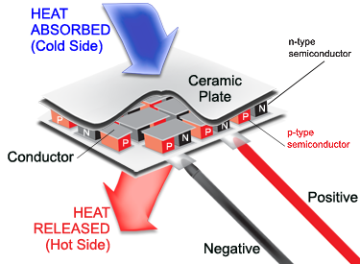
Cooling
To provide the necessary cooling to the sensors the following options should be investigated:
Venturi tubes
Thermoelectric coolers
A venturi creates a constriction within a pipe (classically an hourglass shape) that varies the flow characteristics of a fluid (either liquid or gas) travelling through the tube. As the fluid velocity in the throat is increased there is a consequential drop in pressure.
When a voltage is applied to it, heat is transferred from one side to the other, creating a temperature difference. Peltier effect.

